Slide 1
ML Final Project
08Dec2022
Darian Yang

Slide 2
Background & Motivation (FLOCHART)
Simulation timescales are too slow
Can be solved with path sampling algorithms
Most path sampling requires a “progress coordinate” to sample along
Results are highly dependent on this non-obvious choice
Let’s optimize the progress coordinate choice process with machine learning
The test system: HIV-1 Capsid Protein

Slide 3
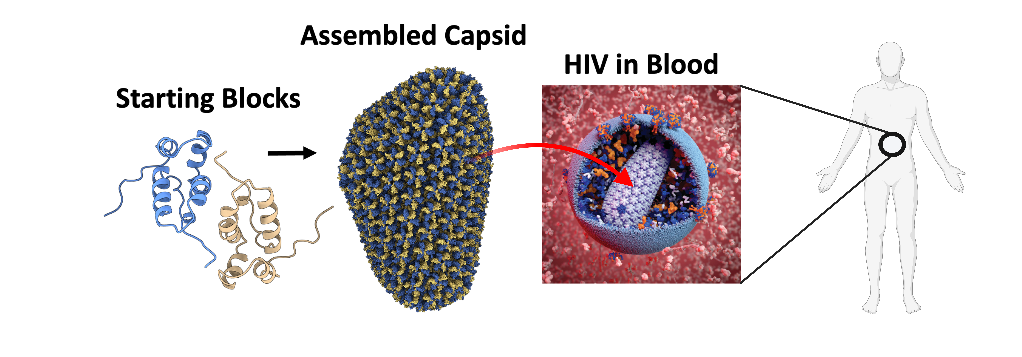
Human Immunodeficiency Virus 1 (HIV-1)
Notes:
After 8-10 years of HIV infection, CD4 lymphocyte cell count usually falls low enough to progress into AIDS

Slide 4
A Splitting-based Enhanced Sampling Algorithm

Slide 5
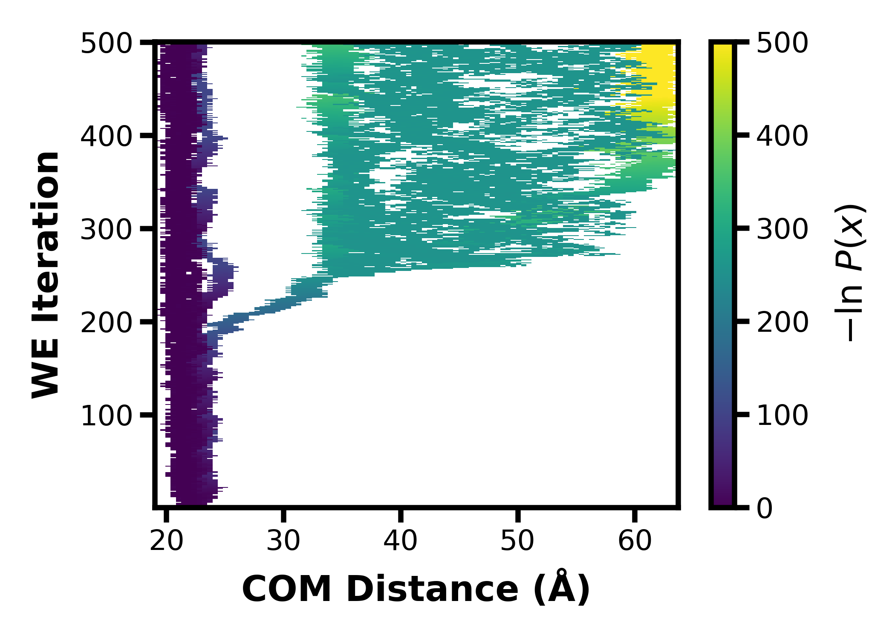
Dataset Curation
Example of failed
Example of success

Slide 6
EDA and Processing
Input:
West.h5:
∆values at every tau (then standardized)
Rows = every segment
Columns = every feature (pcoord and aux data)

Slide 7
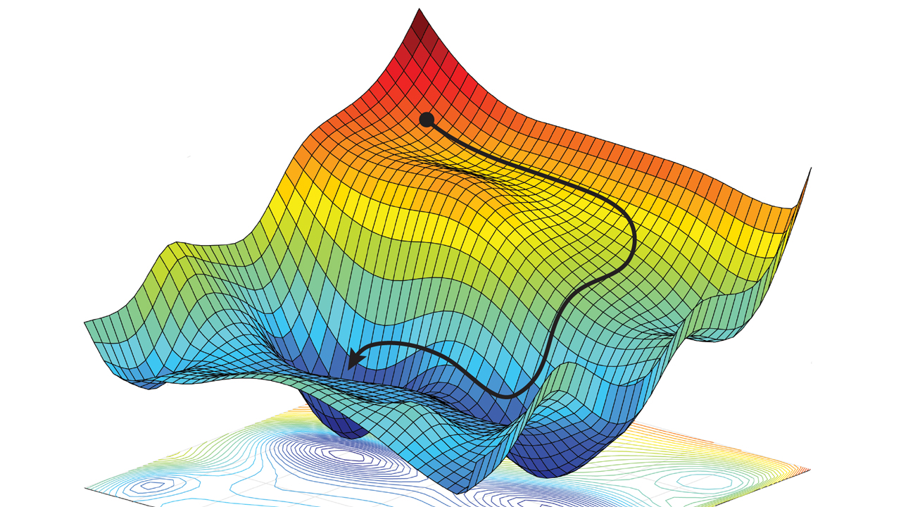
A ML-based pcoord for WE
Optimization of feature weights
Objective function : ROCAUC score
Output is a set of weights for each feature
A linear combination of these weighted features becomes the new progress coordinate

Slide 8
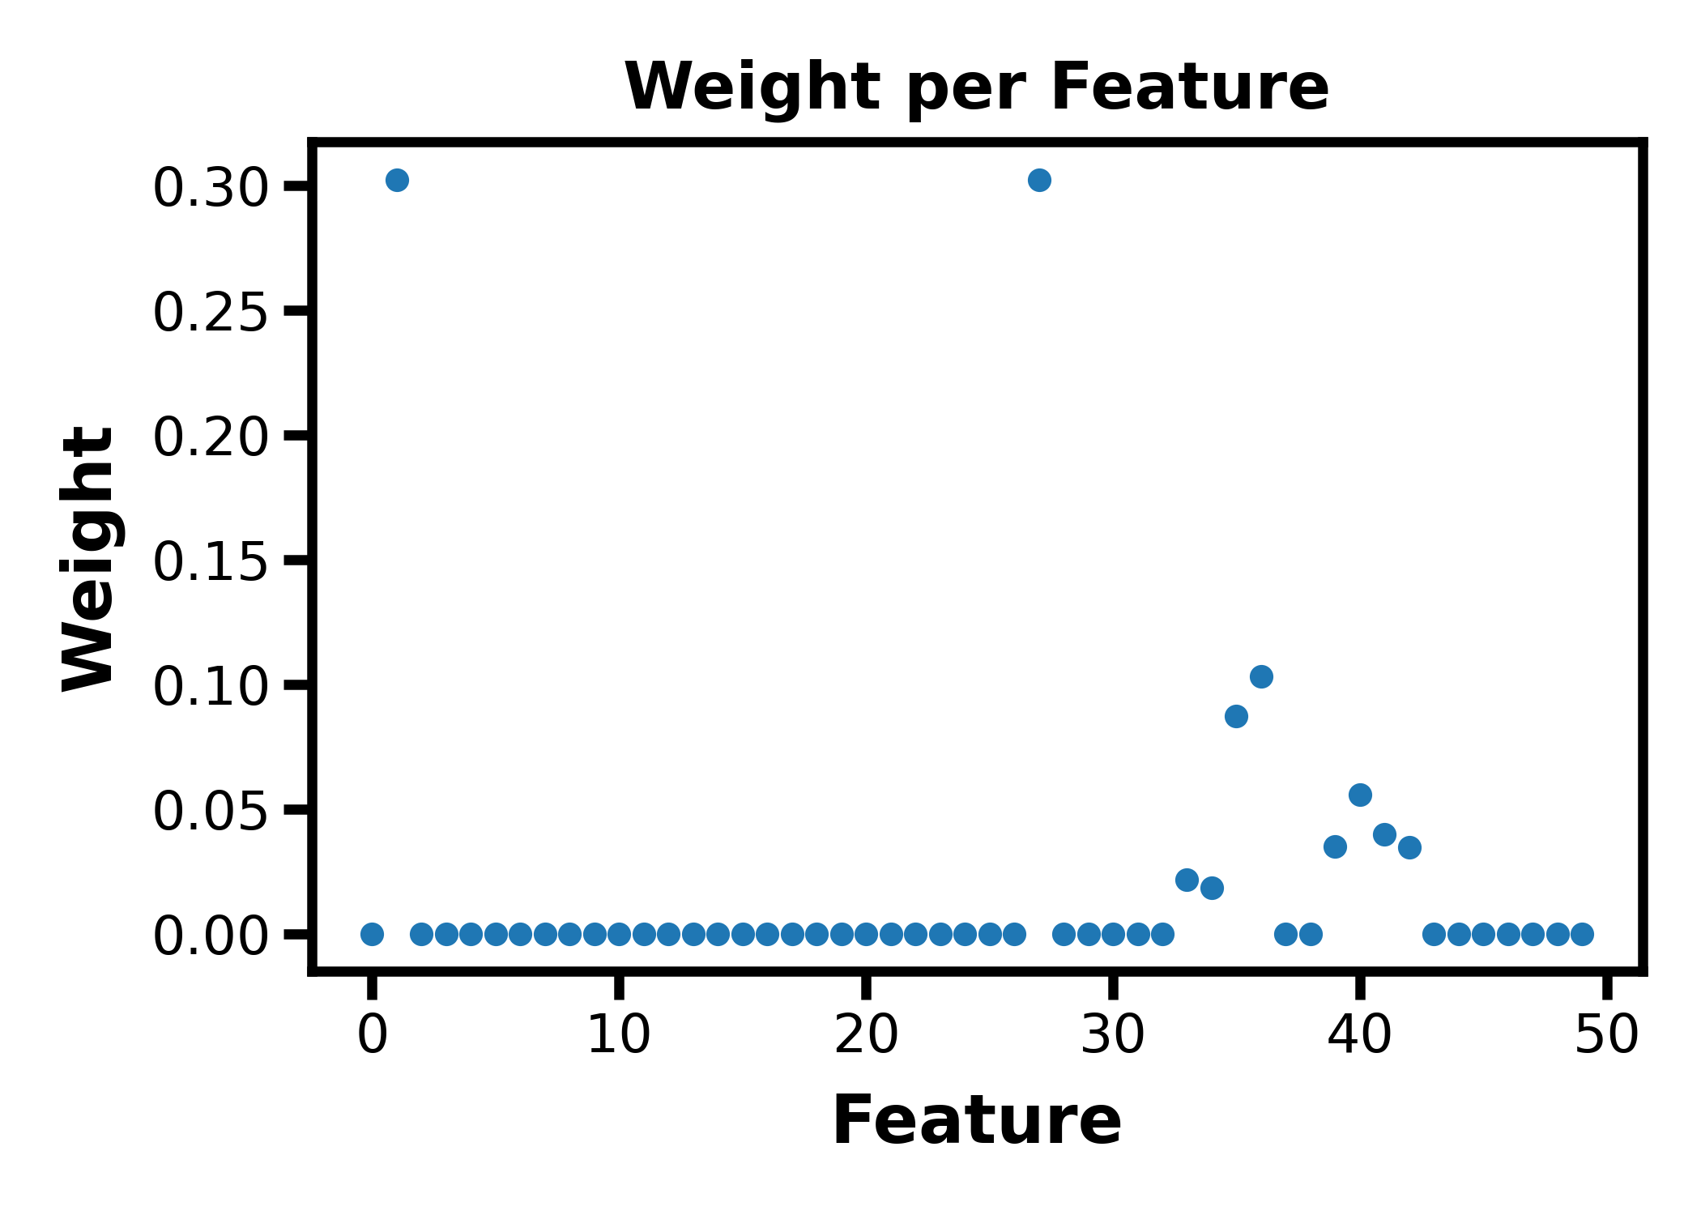
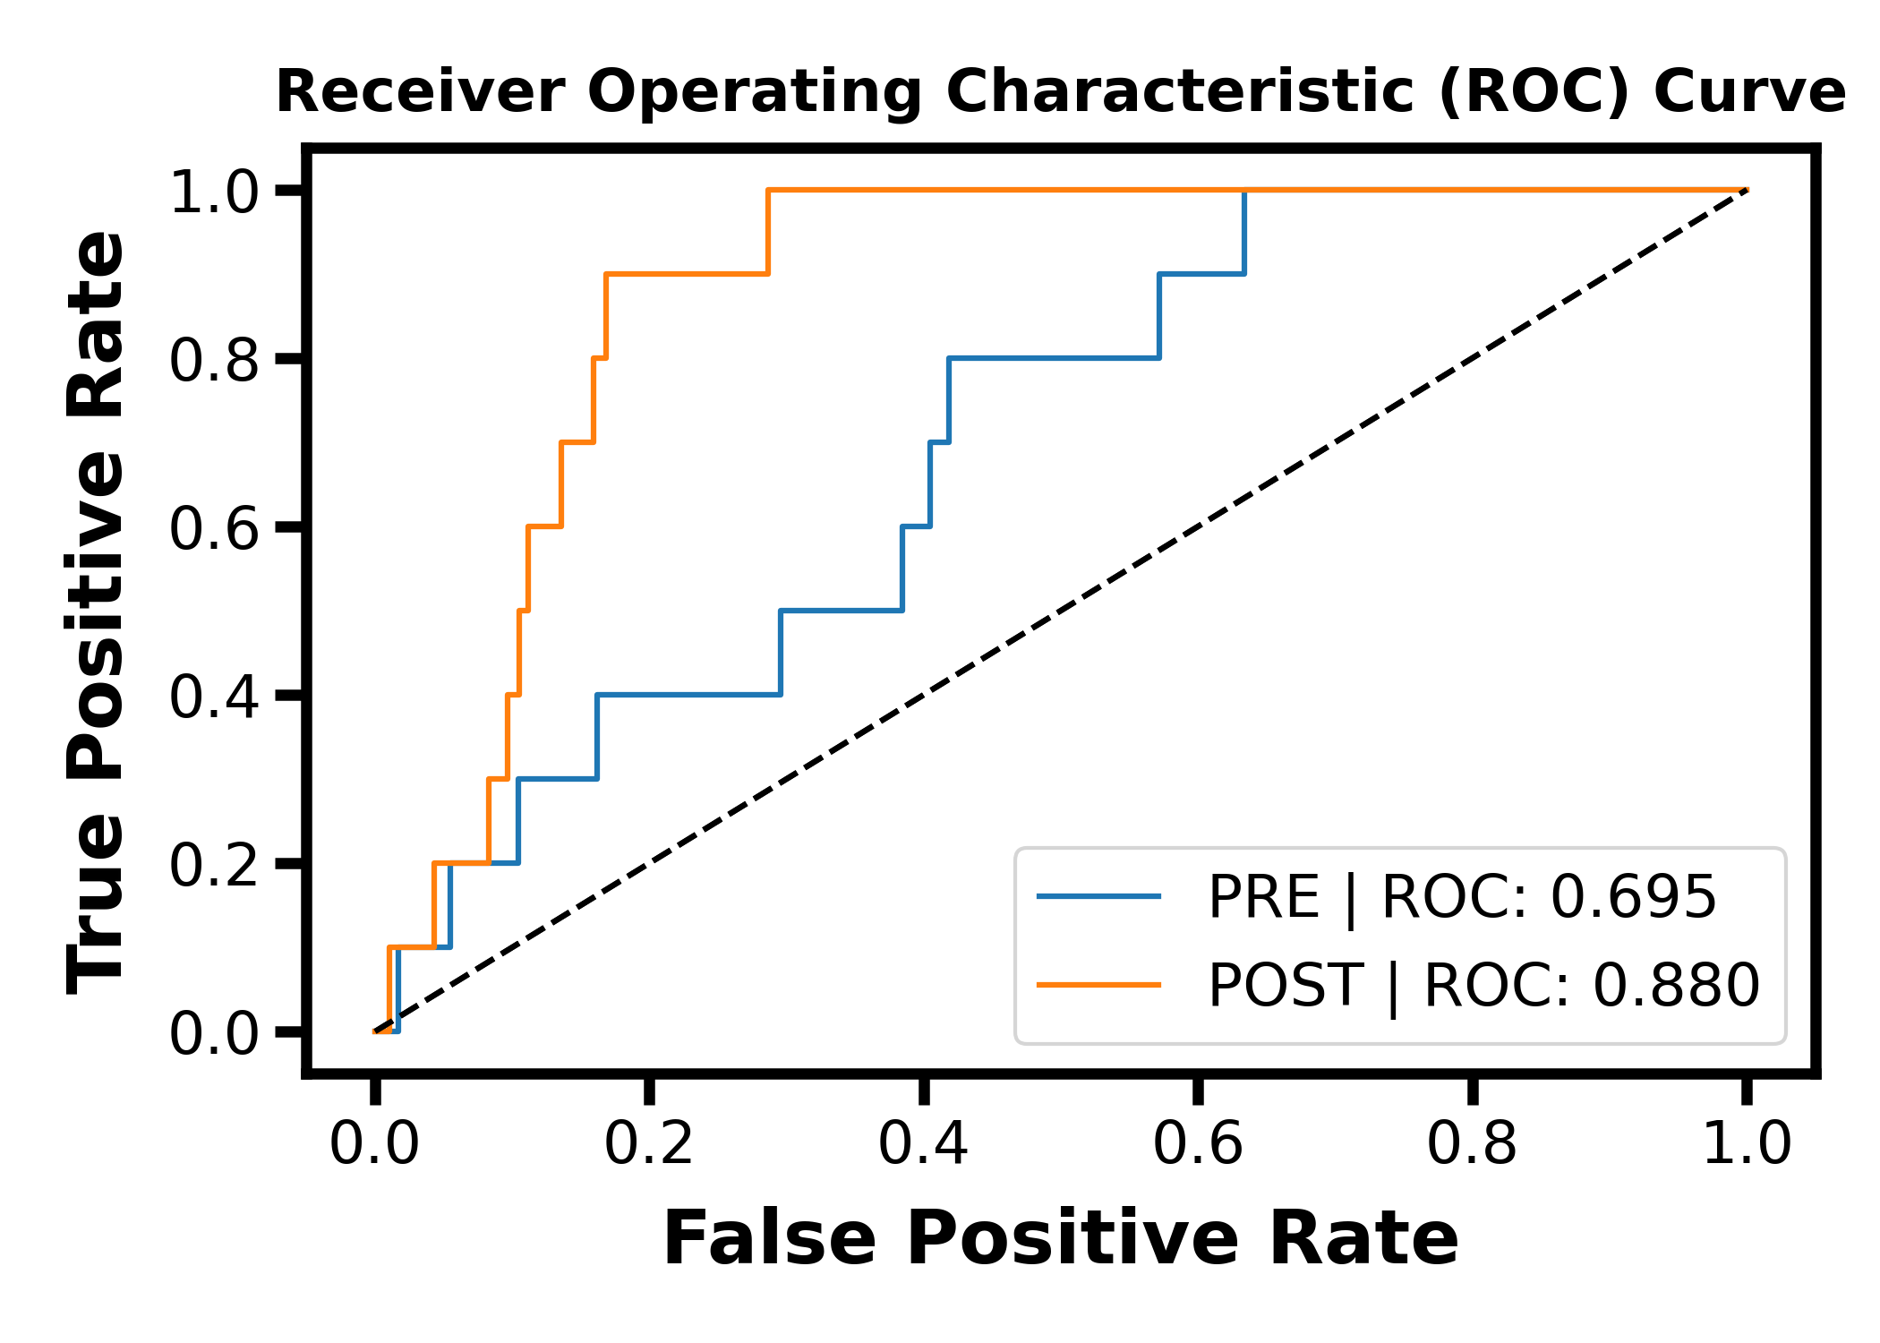
Optimization results

Slide 9
Optimization results (random)

Slide 10
Ideas & steps moving forward:
Improve/change loss function
Perhaps using variation maximization
Weighted distance matrix of features
Could be a useful way towards a more automated pcoord with binless resampler
Or a different scoring metric (e.g. rmse)
Change input dataset
How it is generated
The west.h5 input
Optimizing noise levels
Maybe adding another layer
E.g. optimizing weight of each iteration
Testing the optimized pcoord in a follow-up WE simulation

